Slide 1
ITSC 200 – Network Protocols and Security
Operating Systems

Slide 2
Today’s Objectives
Understand the purpose of an operating system
Become familiar with the major operating systems
Be able to distinguish the different types of operating systems
Understand the history of Windows operating system
Understand the history of the UNIX and Linux operating systems
Complete some basic operations in a virtual Linux machine

Slide 3
Operating Systems
Operating Systems
Give the computer hardware “intelligence” to perform tasks.
Store files
“talk” to other computers through a network
Keep track of different users
Allow users to input data and get data out
Apply some security so only authorized users can access files they should have access to.
Manage the hardware resources like memory (RAM), hard disk space, and input/output devices.
Run user programs to perform specific tasks

Slide 4
Operating Systems
Operating systems can be designed for single users or multiple, simultaneous users.
Earlier operating systems were designed to run on large mainframes which often supported 1000’s of users.
They had a profound effect on the development of the operating systems we use today.
Almost all of the operating systems we use today came from two main sources:
MS-DOS/Windows
UNIX

Slide 5
Some Basic Concepts
The smallest unit of information in a computer is a “bit”
How much information can be stored in 1 bit ?
How can we overcome this limitation ?

Slide 6
Some Basic Concepts
The smallest unit of information in a computer is a “bit”
How much information can be stored in 1 bit ?
Two states ( 0 or 1, On or Off, Yes or No, etc.)
How can we overcome this limitation ?
Use “chunks” of bits together.
The (2)^{number of bits} represents the amount of information that can be stored by using more than 1 bit for storage.

Slide 7
Some Basic Concepts
A byte is 8 bits. How much information can we store with 8 bits ?
(2)⁸ = 2 x 2 x 2 x 2 x 2 x 2 x 2 x 2 = 256 different values
Remember, though, that like all geeks, we start counting at 0 not 1. So the highest value that you can store with 8 bits is 255, not 256.

Slide 8
Converting Binary
The easiest way to convert from binary to decimal is to simply construct a chart. We have place values in binary just as we have them in decimal.
Remember in elementary school when you had to do the worksheets in math.
How many 1’s, 10’s, and 100’s are in the following number ? 256
Answer : 2 100’s, 5 10’s , and 6 1’s

Slide 9
Converting Binary
We do exactly the same thing with binary but the place values are different.
Decimal
Binary
1000 | 100 | 10 | 1
0 | 2 | 4 | 2
= 242
128 | 64 | 32 | 16 | 8 | 4 | 2 | 1
1 | 1 | 1 | 1 | 0 | 0 | 1 | 0
= 242

Slide 10
Parts of the Computer Controlled by the Operating System
RAM (Random Access Memory) is the “working” memory of the computer. Contents are lost when the computer is turned off.
Storage is the non-volatile (survives a computer reboot) memory and there are several that are used in computers.
ROM (Read Only Memory) contains programs that are in hardware and can’t be changed
BIOS (Basic In/Out System) usually stored in CMOS which is a type of chip. BIOS can only be accessed during (actually right after) the POST (Power On Self Test)

Slide 11
Parts of the Computer Controlled by the Operating System
Storage
Flash is non-volatile. This is what a small USB thumb drive is. Be careful because to “flash” something in computers is to completely over-write what is already there.
Hard disk can be a conventional spinning platter disk, or can be solid state, or a combination of the two.
Input / Output devices
Input : Keyboards, barcode scanners, touch screens, etc.
Output : Speakers, monitor, network card, etc.

Slide 12
Parts of the Computer Controlled by the Operating System
CPU (Central Processing Unit) is the “brains” of the computer and what will do almost all of the processing.
Many video cards also have a CPU that is called a GPU (Graphic Processing Unit) that is optimized for numerical processing which is the basis of computer graphics.
You will learn later how these can be used to speed up cryptographic calculations.

Slide 13
Interacting with the Operating System
All interaction with operating system is done through a “shell”
A shell can be character-based or graphical.
Most security tasks are done through character-based shells at the commandline.
Businesses and individuals use two main operating systems :
Windows
UNIX/Linux
(the Mac OSX operating system is a UNIX variant)

Slide 14
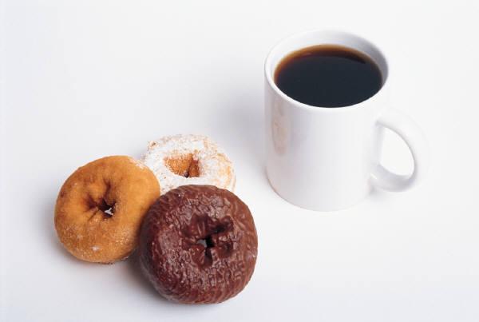
Coffee Break!

Slide 15
UNIX
First developed and used inside Bell Labs starting about 1970, but started to be distributed by AT&T about 1973.
It was originally distributed with source code so several universities started using it to teach higher-level computer science courses.
By 1980 UNIX was available for Intel-based PC’s
AT&T tried to commercialize UNIX and almost destroyed it in the process.

Slide 16
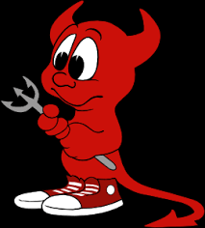
UNIX
The University of California, Berkeley started improving the UNIX code and distributing it. They called it Berkeley Software Distribution (BSD UNIX).
Their greatest contribution was the inclusion of the TCP/IP protocol in UNIX. Other UNIX’s did not support TCP/IP at the time.
Beastie, the BSD mascot

Slide 17
UNIX
Richard Stallman of MIT formed the GNU project which tried to give users freedom to control their own computers. The word “free” in this context always refers to freedom.
UNIX is still popular today but most commercial variants (ie: HP-UX) cannot call their product “UNIX” since the word is trademarked.
Everything started to change in the early 1990’s when Linux was released. It is a UNIX-like clone that uses no UNIX source code. Like all GNU software, it is free.

Slide 18
Linux
The use of Linux grew rapidly as it was not only free but allowed anyone with a UNIX background to seamlessly start using Linux.
If you know Linux, you are well on your way to learning UNIX.
Today, there are many variants of Linux (called “distributions”) but most come from three original distributions:
Redhat Linux
Debian Linux
Slackware Linux

Slide 19
Linux
Because of the original three distributions, you will often hear people say things like “CentOS Linux is a Redhat-based distro” , meaning that the CentOS distribution derives from Redhat.
This is important because when you have a job interview and the interviewer asks you if you are familiar with say, Mint Linux, you can say “I’m comfortable with Ubuntu Linux and both Mint are Ubuntu are Debian-based distros.”
Check out http://www.distrowatch.com

Slide 20
Linux
Most of the commands in the various Linux distributions are identical regardless of the distribution.
The one area of difference is in the package managers.
The package managers are used to install, update, and remove software applications.
In Linux, you rarely have to manually download and install a package. You simply ask to install it and the package manager downloads it, checks for other required packages (dependencies), and installs it.

Slide 21
Linux Package Managers
Wireshark is a software package that you will use extensively in this course. Below are the commands that you would use to install it on two different distributions :
Redhat or CentOS Linux
Sudo yum install wireshark
Debian, Ubuntu, or Mint Linux
Sudo apt-get install wireshark
We have to preface both commands with “sudo” because we are not normally logged in as administrator (root). The sudo command allows us to invoke root privileges for the one command.

Slide 22
MS-DOS/Windows
MS-DOS (Microsoft Disk Operating System)
Single user
Single tasking
Initially released in 1981 and development stopped in 2000
Microsoft already had a full multi-user, UNIX-based operating system called Xenix which they eventually sold to Santa Cruz Operation (SCO).

Slide 23
MS-DOS/Windows
MS-DOS and versions of Windows up to, but not including, Windows NT were 16 bit.
MS-DOS had a command-line interface (CLI)
Starting with Windows, a Graphical User Interface (GUI) was added
If you want to feel the power of MS-DOS, DOSBox is a free program that runs under Linux or Windows.

Slide 24
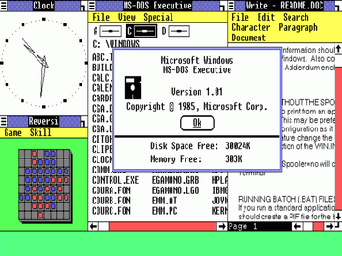
Windows
Initial release in 1985
Networking capabilities weren’t added until Windows for Workgroups in 1993
Windows NT 3.1, the first 32 bit Windows OS was released in 1993.
Successive releases competed with Novell Netware, the dominant network operating system.
Windows 1.0 1985

Slide 25
Windows
Windows is now available for the Intel 64 CPU architecture and the ARM CPU architecture. It also runs on the Xbox.
As of December 2020, Windows accounted for 76.6% of desktop PC’s connected to the Internet. Mac OS accounted for about 17% and Linux accounted for about 2%.
As of November 2020, however, Linux ran on about 40% of Internet servers while Windows ran on about 28%. Most of the remaining (about 32%) “hid” the identification of their operating system.

Slide 26
Using Operating Systems
Where am I ?
Who am I ?
How can I read / store / modify files ?
How are the operating system files arranged ?
How can I run a program / command ?
How can I organize my own files
How can I install programs ?
How can I find help and log files ?

Slide 27
Virtualbox on your Laptop
Verify that everyone has Virtualbox on their computer
Instructor demonstration of creating a new virtual Linux computer in Virtualbox.

Slide 28
Important Linux/UNIX Concepts
Everything is a file.
All input and output is to / from files
All devices are treated as files
A “Lego” approach to managing the system.
Small, special purpose programs are preferred over large, monolithic programs
Using several small programs together allows us to customize our commands as needed.
Notes:
<number>

Slide 29
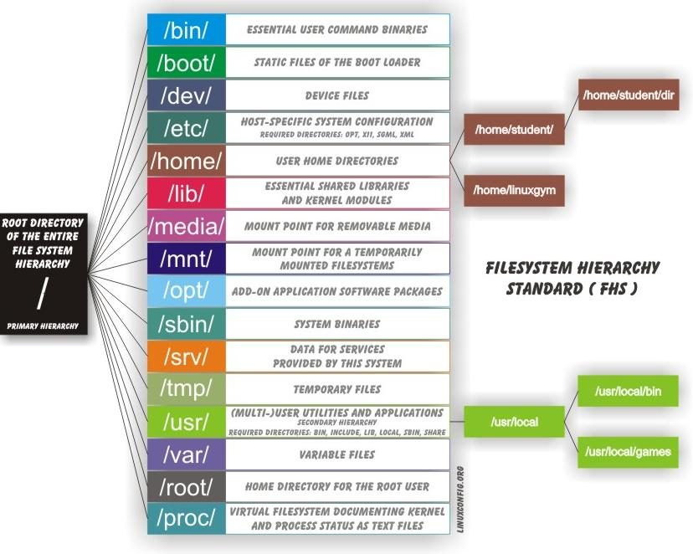
File System
Graphic from https://linuxconfig.org/filesystem-basics

Slide 30
Linux Filesystem
/bin contains binary (program) files belonging to the operating system
/sbin contains binary (program) files belonging to the operating system but for use by the system and the administrator
/boot contains the files needed to boot the OS
/dev contains the files representing devices in the system (DVD, hard drive, keyboard, etc.

Slide 31
Linux Filesystem
/etc is important directory for us because it contains the configuration files and daemon boot scripts
/home is where user home directories are kept (except the root user)
/lib contains libraries that are needed by executables
/tmp contains temporary files like lock files and print jobs
/var contains files that change frequently, but most importantly for us, it contains log files

Slide 32
Linux Filesystem
/root is the root user’s home directory
/proc is a virtual directory created when the system boots and contains files and directories that represent running processes
/usr is a special directory that often has many of the same directories as the root in it ( /usr/bin and /usr/sbin ) and serves to separate operating system binaries and files from server application files added later

Slide 33
Linux Filesystem Commands
Before we can use the filesystem, we need to be able to determine where in the filesystem we are, and be able to specify exactly where we want to go in the file system.

Slide 34
Basic Filesystem Commands (remember : Linux is case-sensitive)
mkdir : make a directory
rm : remove a file (delete)
rmdir : remove a directory and all contents and subdirectories
mv : rename and/or move a file
cp : copy a file or directory to a another location
pwd : print the path of your current directory (where am I ?)
ls : list the contents of a directory
more : look at the contents of a text file one screen at a time
cat : look at a text file all at once
cd : change directory
Notes:
<number>

Slide 35
How to Correctly Shutdown your Linux Computer
shutdown -r now
shutdown -h now
shutdown -h 09:30 “Going down for maintenance”
shutdown -h +120 “Shutting down for power outage”
Notes:
<number>

Slide 36
Moving Around
Using the pwd command to find out where we are.
Using absolute versus relative paths
Using whoami to find out what user account you are logged into.
Using ifconfig or ip addr to find your IP address
Using the cp, mkdir, rm, and mv commands

Slide 37
Using Operating Systems (Linux)
Download linux_cheatsheet_1.pdf
Download Operating Systems Lab 1

Slide 38
End

